Slide 1


CMPE 135: Object-Oriented Analysis and Design October 26 Class Meeting
Department of Computer Engineering San Jose State University Fall 2017 Instructor: Ron Mak
www.cs.sjsu.edu/~mak

Slide 2
Design Patterns
Strategy Pattern
Observer Pattern

Slide 3
Example: Starbuzz Coffee
They’ve grown so fast that they now must update their ordering system to match their beverage offerings.
This example and its images are from
Head First Design Patterns
by Eric & Elizabeth Freeman
O’Reilly, 2004

Slide 4
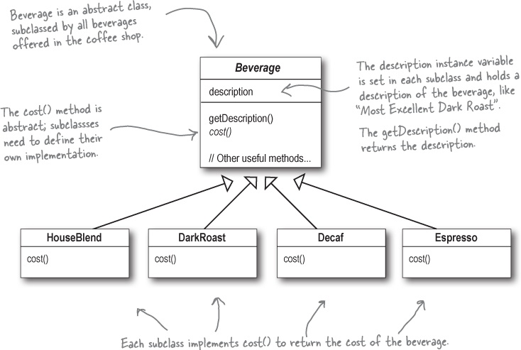
Initial Design

Slide 5
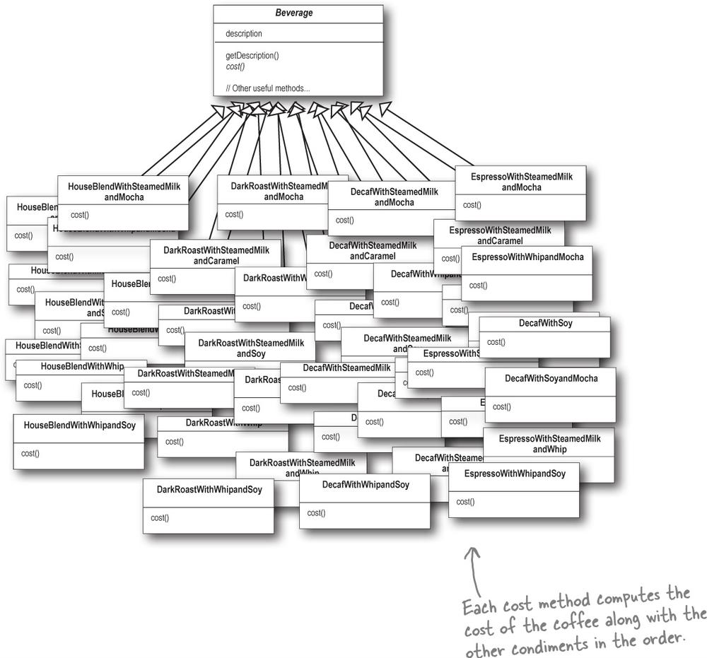
Initial Design, cont’d
Charge extra for condiments:

Slide 6
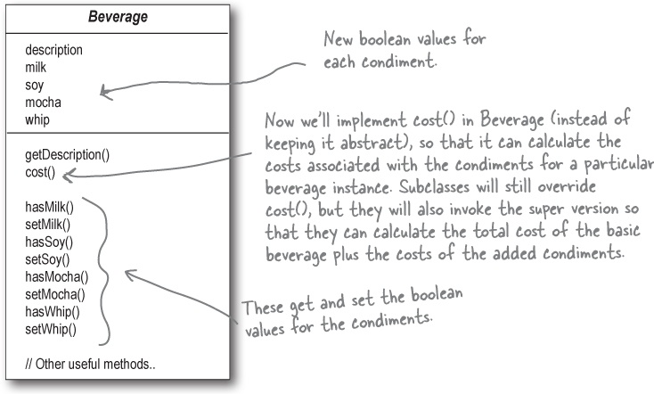
Second Design
Use instance variables and inheritance in the base class to keep track of the condiments:

Slide 7
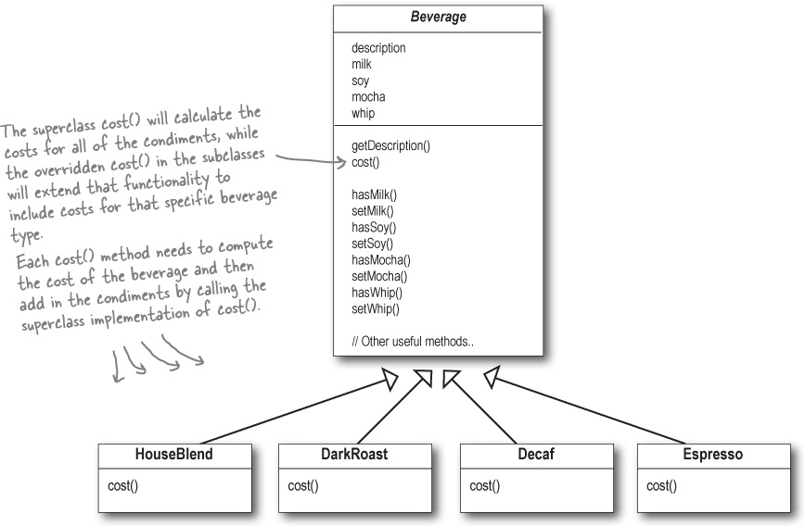
Second Design, cont’d
One subclass per beverage:

Slide 8
Second Design, cont’d
Problems with this solution?
Price changes for condiments
New condiments
New beverages such as iced tea, which for some the current set of condiments may be inappropriate
Double mocha?

Slide 9
Recall: The Open-Closed Principle
Allow classes to be easily extended to incorporate new behaviors without modifying existing code.
Designs that are resilient to change and flexible enough to meet changing requirements.

Slide 10
The Decorator Pattern
Take a DarkRoast object.
Decorate it with a Mocha object.
Decorate it with a Whip object.
Call the cost() member function and rely on delegation to add on the condiment costs.

Slide 11
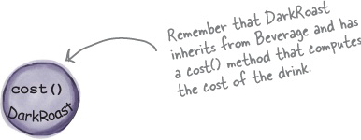
The Decorator Pattern, cont’d
Start with a DarkRoast object.

Slide 12
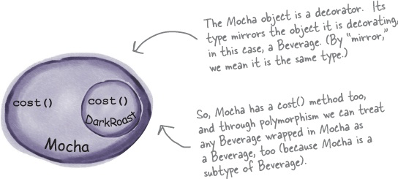
The Decorator Pattern, cont’d
The customer wants mocha, so create a Mocha object to wrap around the DarkRoast object.

Slide 13
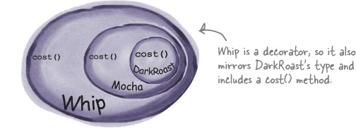
The Decorator Pattern, cont’d
The customer also wants whip, so create a Whip decorator to wrap around the Mocha object.

Slide 14
The Decorator Pattern, cont’d

Slide 15
The Decorator Pattern, cont’d
How about that double mocha?

Slide 16
The Decorator Pattern, cont’d
Decorators have the same supertype as the objects they decorate.
You can use one or more decorators to wrap an object.
Given that the decorator has the same supertype as the object it decorates, we can pass around a decorated object in place of the original (wrapped) object.
The decorator adds its own behavior before and/or after delegating to the object it decorates to finish the job.
Objects can be decorated at any time, so we can decorate objects dynamically at runtime with as many decorators as we like.

Slide 17
The Decorator Pattern, cont’d
The Decorator Pattern attaches additional responsibilities to an object dynamically.
Decorators provide a flexible alternative to subclassing for extending functionality.

Slide 18
Decorator Pattern UML

Slide 19
Starbuzz Design

Slide 20
Starbuzz Implementation
Abstract Beverage class:

Slide 21
Starbuzz Implementation, cont’d
Abstract Condiments class:

Slide 22
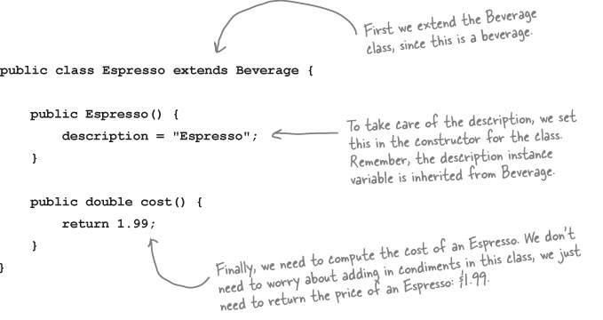
Starbuzz Implementation, cont’d
Code beverages:

Slide 23
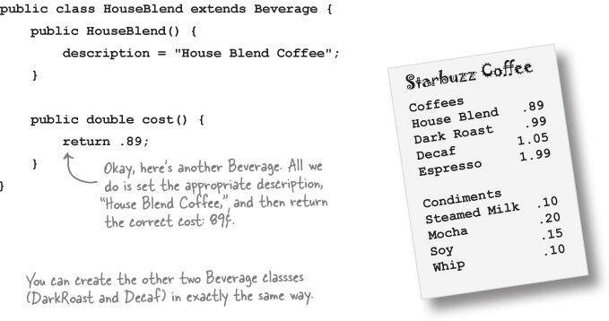
Starbuzz Implementation, cont’d
Code beverages, cont’d:

Slide 24
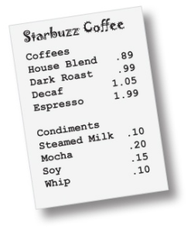
Starbuzz Implementation, cont’d
Code condiments

Slide 25
Starbuzz Test

Slide 26
Starbuzz Test, cont’d
Test run:
Each condiment decorator depends on the object it wraps to calculate the wrapped object’s cost, to which the condiment adds its cost.
Thus, the cost calculation is a chain from the outermost condiment wrapper down to the beverage.

Slide 27
Decorator Pattern Caveats
A wrapped beverage still “is a” beverage.
Abstract class CondimentDecorator is a subclass of abstract class Beverage.
Code to the interfaces (abstract superclasses), not to a specific concrete component.
For example, you would break the Decorator Pattern if your code must “reach into” the chain of wrappers to a specific concrete class, such as HouseBlend, in order to offer a special discount for that beverage.

Slide 28
Decorator Pattern Caveats, cont’d
Decorators are meant to add behavior to the object they wrap.
The decorator adds its own behavior before and/or after delegating to the object it decorates.
The decorated object may itself be decorating another object, thereby adding to the calculation chain.
The Decorator Pattern can be overused and multiply into many small objects, making the overall design complex.

Slide 29
Assignment #4
(Complete write-up forthcoming!)
Look for examples of the use of design patterns in your project code.
For each pattern:
Write a short description of the context in which the pattern appears.
Draw a UML class diagram that shows how your project implements the design pattern.

Slide 30
The Decorator Pattern

